Slide 1
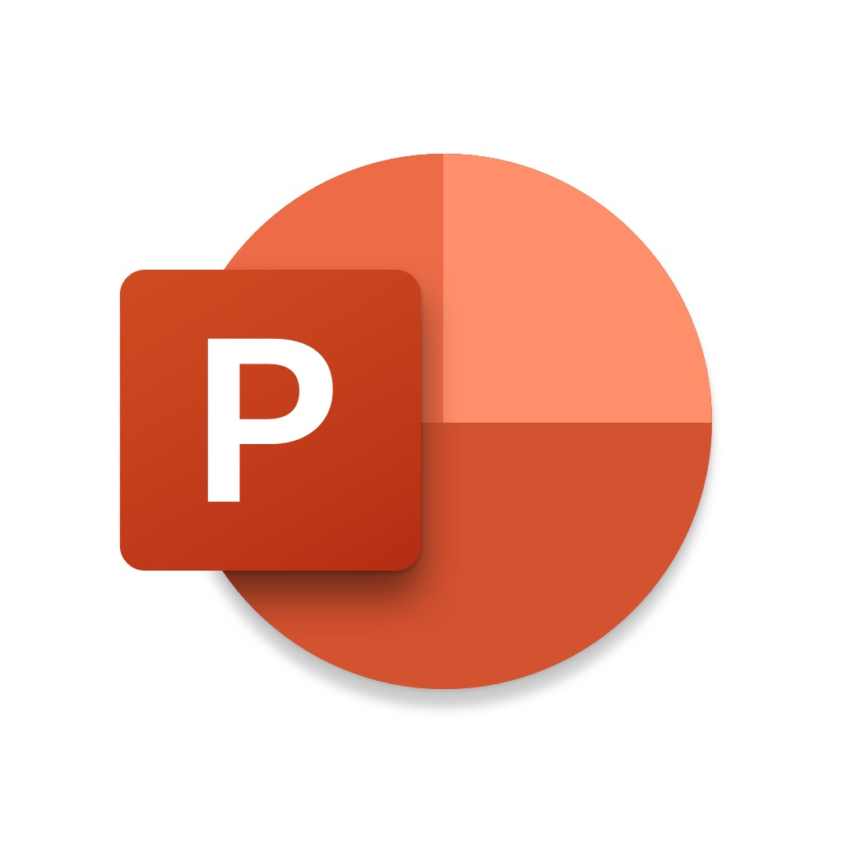




Applications and Services
Used for creating the layout
PowerPoint
GitHub
Ben Dodson
Paint.NET
Graphic design
Image Database
iTunes Artwork Finder
Layout Cropping
Fonts
Aa Bb Cc Dd
Aa Bb Cc Dd
San Francisco Pro Display
San Francisco Pro Text
Apple Inc.
Apple Inc.
Color Presets
#786558
#9F8B7D
#D9CAC1
#FFFFFF
rgb(120,101,88)
rgb(159,139,125)
rgb(217,202,193)
rgb(255,255,255)

